Slide 1
Correlation

Slide 2
Outline
Correlation
Interpreting correlation coefficients
Describing Relationships
Pearson Correlation Assumptions
Spearman's Correlation
Correlation does not imply Causation

Slide 3
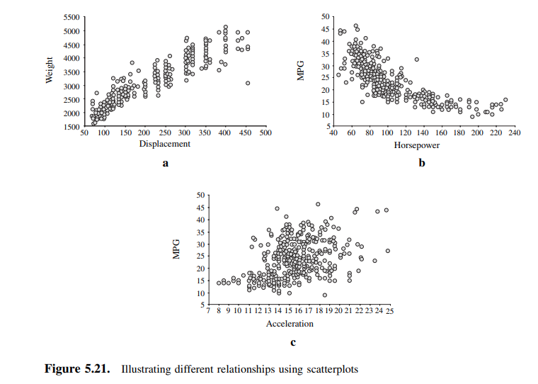
Visualizing Relationships between variables
Test whether the patterns that you observe in a sample dataset are likely to be present in the broader population or whether those patters are a product of chance.

Slide 5
In a there is a positive relationship between the two variables and from inspection appears to be linear.

Slide 6
In b, there is a negative relationship between the variables and it also appears to be non linear.

Slide 7
In c, it is difficult to see any relationship between the two variables.

Slide 8
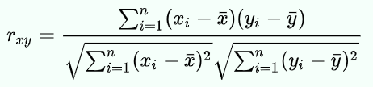
Correlation
Correlation measures the strength of the relationship between two variables. In other words, it tells you how closely two variables are related.
There are other types of correlation and the most popular is called Pearson product-moment correlation

Slide 9
Correlation
Positive correlation. This is when two variables move in the same direction. For example, as the price of a stock goes up, the number of shares traded also goes up.
Negative correlation. This is when two variables move in opposite directions. For example, as the price of a stock goes up, the number of shares traded goes down.

Slide 10
Correlation
Correlation is measured on a scale from -1 to +1.
A value of -1 means that the variables are perfectly negatively correlated.
A value of +1 means that the variables are perfectly positively correlated.
A value of 0 means that the variables are not correlated at all.

Slide 11
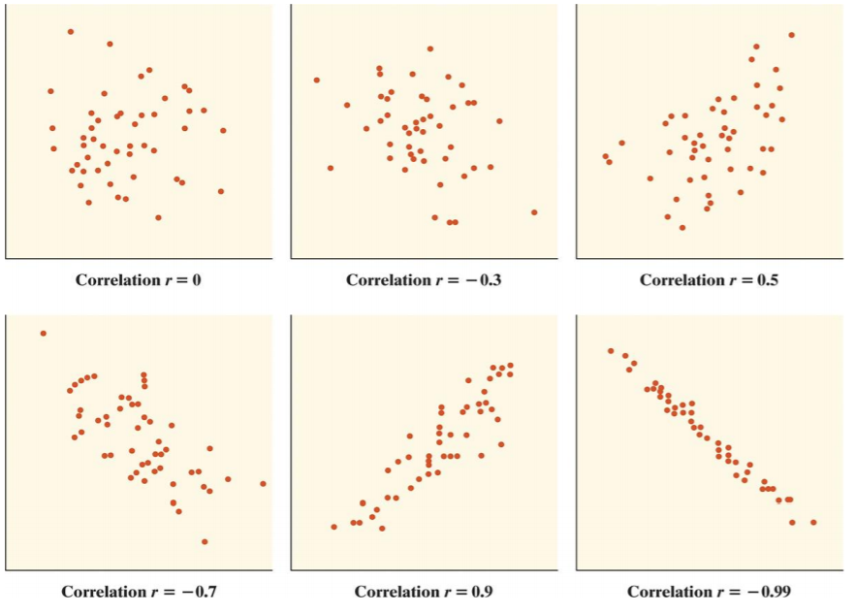

Slide 12
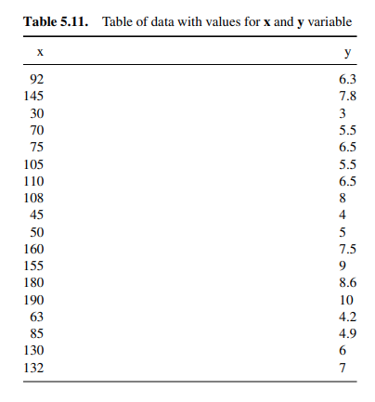
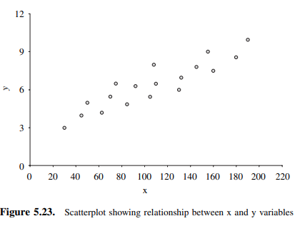

Slide 13
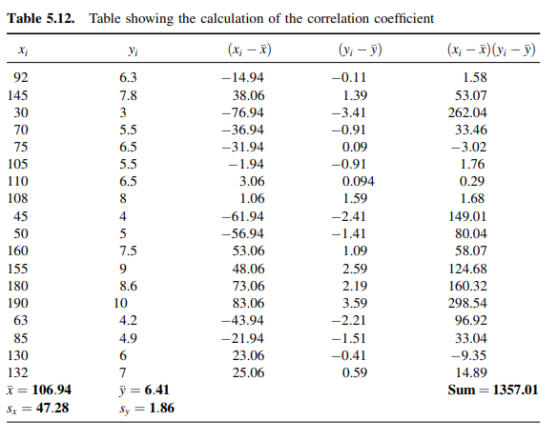
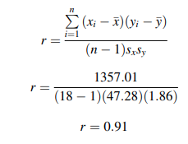

Slide 14
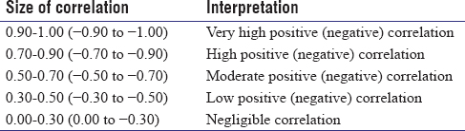

Slide 15
The strength of the relationship given by the correlation coefficient.

Slide 16
2. The direction of the relationship, which can be positive or negative based on the sign of the correlation coefficient.

Slide 17
3. The shape of the relationship, which must always be linear to computer a Pearson correlation coefficient.

Slide 18

$$p=0.0004$$
4. Whether or not the relationship is statistically significant, which is based on the p-value.

Slide 19
When describing relationships…
Four things must be reported to describe a relationship:
The strength of the relationship given by the correlation coefficient.
The direction of the relationship, which can be positive or negative based on the sign of the correlation coefficient.
The shape of the relationship, which must always be linear to computer a Pearson correlation coefficient.
Whether or not the relationship is statistically significant, which is based on the p-value.

Slide 20
Assumptions for Pearson Correlation
Level of measurement refers to each variable. For a Pearson correlation, each variable should be continuous.
Related pairs refers to the pairs of variables. Each participant or observation should have a pair of values. So if the correlation was between weight and height, then each observation used should have both a weight and a height value.

Slide 21
Assumptions for Pearson Correlation
3. Absence of outliers refers to not having outliers in either variable.
Having an outlier can skew the results of the correlation by pulling the line of best fit formed by the correlation too far in one direction or another. Typically, an outlier is defined as a value that is 3.29 standard deviations from the mean, or a standardized value of less than ±3.29.

Slide 22
Assumptions for Pearson Correlation
4. Your variables should be approximately normally distributed.
In order to assess the statistical significance of the Pearson correlation, you need to have bivariate normality, but this assumption is difficult to assess, so a simpler method is more commonly used.

Slide 23
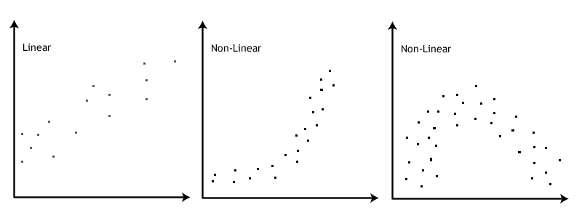
Assumption: No Outliers

Slide 24
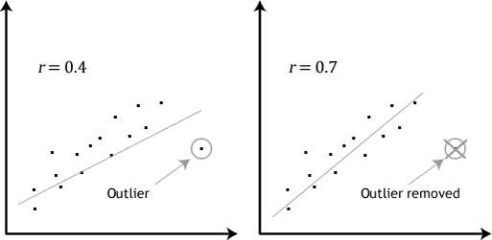
Assumption: No Outliers

Slide 25
Outline
Correlation
Interpreting correlation coefficients
Describing Relationships
Pearson Correlation Assumptions
Spearman's Correlation
Correlation does not imply Causation

Slide 26
Spearman’s rank-order correlation
The Spearman rank-order correlation coefficient (Spearman’s correlation) is a nonparametric measure of the strength and direction of association that exists between two variables measured on at least an ordinal scale.
Spearman’s correlation can be used when your two variables are not normally distributed.
It generates values ranging from -1.0 to +1.0.

Slide 27
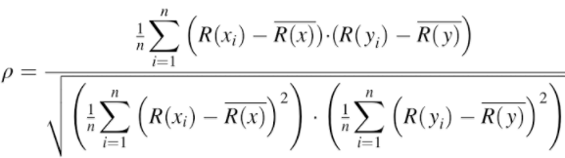

Spearman’s rank-order correlation
No tied ranks
With tied ranks

Slide 28
Assumptions of Spearman’s correlation
1. Your two variables should be measured on an ordinal, interval or ratio scale.
Examples of ordinal variables include Likert scales (e.g., a 7-point scale from "strongly agree" through to "strongly disagree.

Slide 29
Assumptions of Spearman’s correlation
2. Your two variables represent paired observations.
With 30 participants in the study, this means that there would be 30 paired observations.

Slide 30
Assumptions of Spearman’s correlation
3. There is a monotonic relationship between the two variables.
A monotonic relationship exists when either the variables increase in value together, or as one variable value increases, the other variable value decreases.

Slide 31
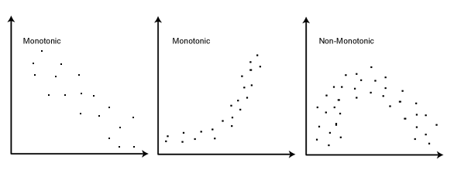
Spearman’s rank-order correlation
3. There is a monotonic relationship between the two variables.

Slide 32
Outline
Correlation
Interpreting correlation coefficients
Describing Relationships
Pearson Correlation Assumptions
Spearman's Correlation
Correlation does not imply Causation

Slide 33
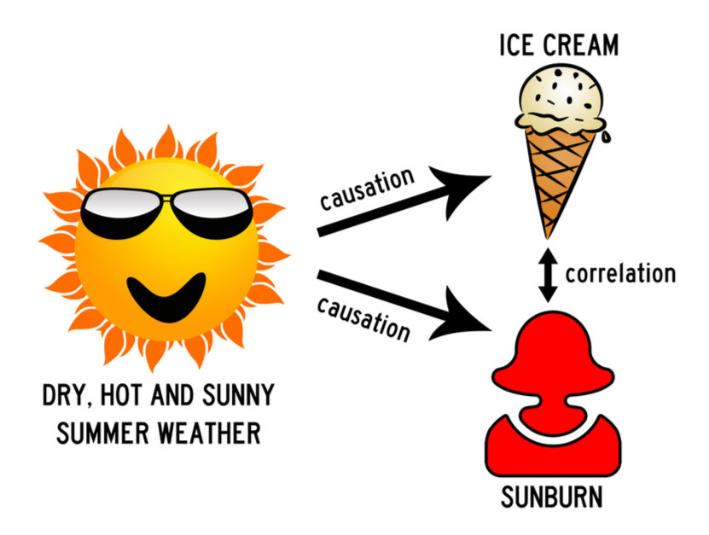
Correlation does not imply Causation
The phrase refers to the inability to legitimately deduce a cause-and-effect relationship between two events or variables solely on the basis of an observed association or correlation between them.

Slide 34
Both ice cream sales and the number of people who have sunburn increase when the weather is hot and sunny.
But they are not caused by each other.

Slide 35
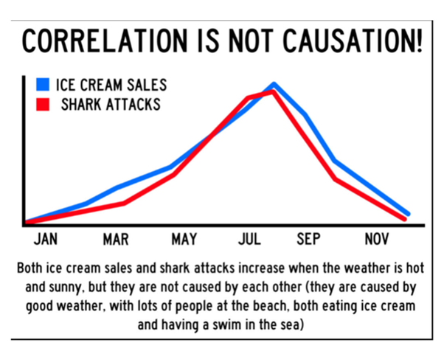

Slide 36
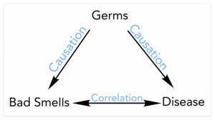
Correlation does not imply Causation
Correlation tells us how strongly the pair of variables are linearly related and change together. It does not tell us why and how behind the relationship but it just says the relationship exists.

Slide 37
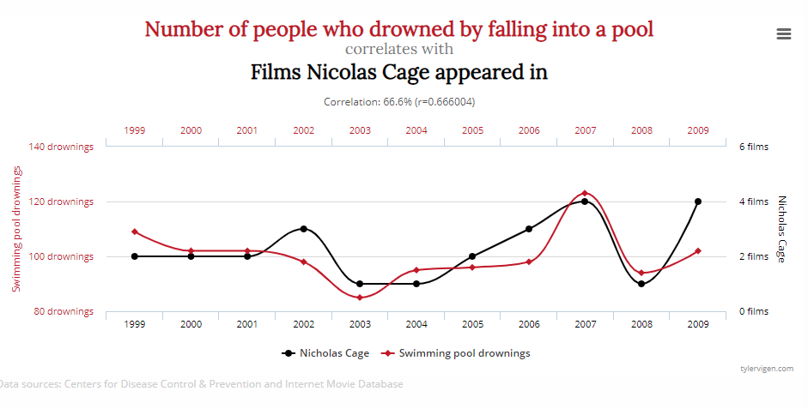
Causation does not imply Causation

